Slide 1
Data Structure and Algorithms
Azaz Ahmed Kiani

Slide 2
Queue Lesson 15
2

Slide 3
Problem to be Solved
We may want to simulate a real life situation of a waiting line, like
A line of people waiting to purchase tickets, where the first person in line is the first person served.
With in a computer system there may be lines of tasks
Waiting for the printer
Waiting for access to disk storage
Or in a time sharing system for use of the CPU.
The data structures used to solve this type of problems is called Queue

Slide 4
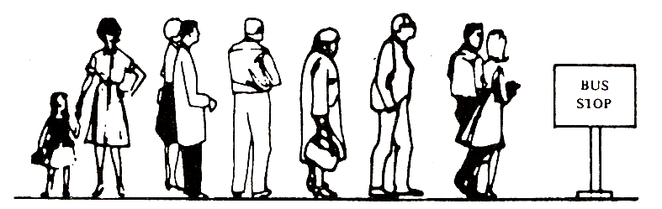
Queue
A linear list in which items may be added only at one end and items may be removed-only at the other end
Another example of a queue is a batch of jobs waiting to be processed, assuming no job has higher priority than the others

Slide 5
Queue
We define a queue to be a list in which
All additions to the list are made at one end, and
All deletions from the list are made at the other end
Queues are also called First-In, First-Out lists, or FIFO for short.
The entry in a queue ready to be served, will be
the first entry that will be removed from the queue,
We call this the front of the queue.
The last entry in the queue is the one most recently added, we call this the rear of the queue

Slide 6
Queue
Deletion (Dequeue) can take place only at one end, called the front
Insertion (Enqueue) can take place only at the other end, called the rear
The general Queue model is
Queue Q
Dequeue( ) Enqueue (x)
6

Slide 7
Queue Concept

Slide 8
Common Operations on Queue
Determine whether a queue is empty
Add a new item to the queue
Remove the item that was added earliest

Slide 9
Queue – Array representation
Maintained by a linear array QUEUE and
Two variables:
FRONT containing the location of the front element of the queue; and
REAR, containing the location of the rear element of the queue
Condition FRONT = -1 will indicate that the queue is empty
whenever an element is deleted from the queue, FRONT = FRONT + 1
whenever an element is added to the queue, REAR = REAR +1

Slide 10
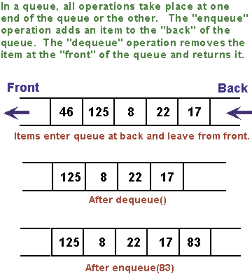
Enqueue and Dequeue Operations

Slide 11
Array Implementation
5
4
6
7
8
7
6
0 1 2 3 4 5 6 7 8
Front=0
Rear=6
8
7
6
0 1 2 3 4 5 6 7 8
Front=4
Rear=6
7
6
12
67
0 1 2 3 4 5 6 7 8
Front=5
Rear=8

Slide 12
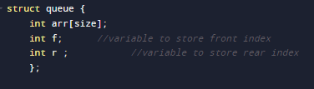
Queue Implementation (Step 1)

Slide 13
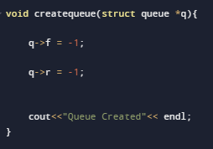
Step 2: Set front and rear to null initially

Slide 14
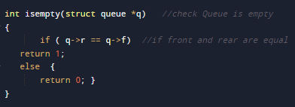
Step 3: Check Queue is Empty?

Slide 15
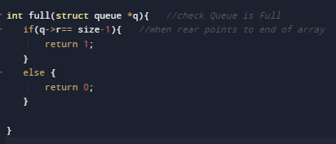
Step 4: Check Queue is Full?

Slide 16
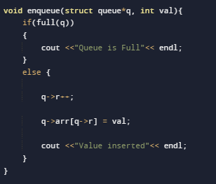
Step 5: en-queue Operation

Slide 17
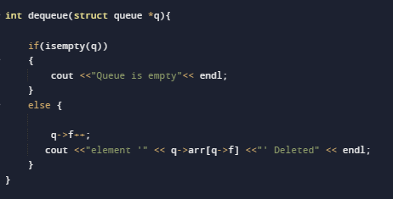
Step 6: de-queue Operation

Slide 18
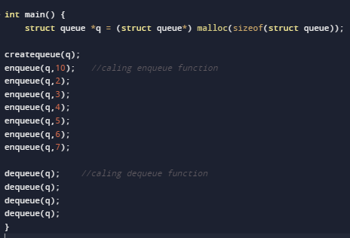
Step 7: main function

Slide 19
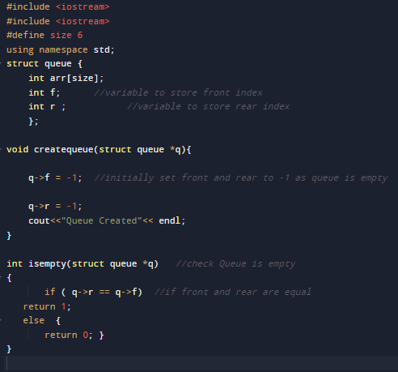
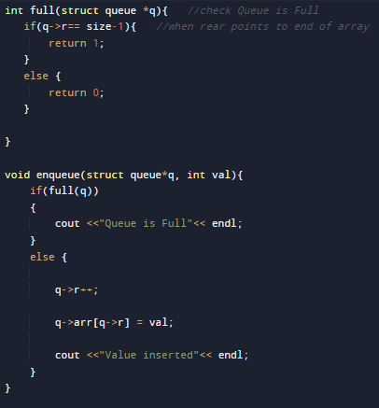
Complete Program

Slide 20
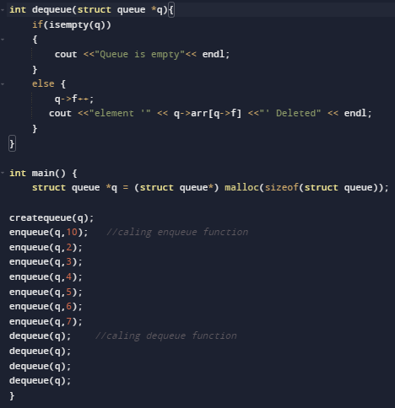
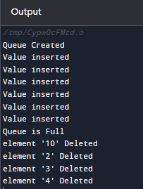
Complete Program

